Slide 1
L.O: To ask questions I need answered about puberty and my body.
We will be thinking about:
Parts of puberty you are unsure or curious about.
Asking questions to find out more.

Slide 2
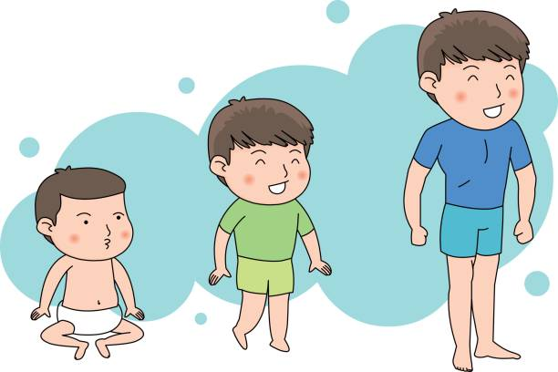
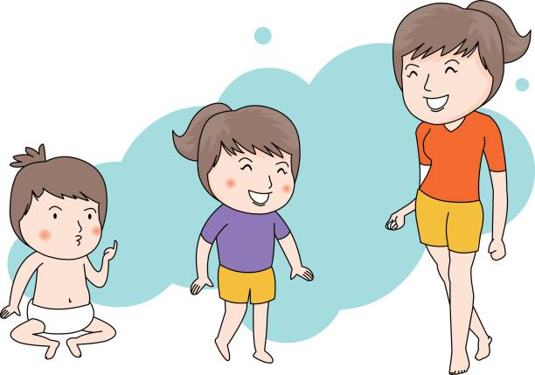
Growing and changing
What’s our starting point?
Think back over last lesson.
Write down one thing about puberty you didn’t know but are now glad you have found out about.
This is just for you, so keep it to yourself. We don’t need to share these ideas.

Slide 3
Rounds…
What do you know about puberty?
We will go round the room, with each person making a statement about changes that happen with puberty. We will start with the word ‘puberty’. Your idea must start with the last letter of the previous person’s statement.
e.g. puberty, you grow taller, relationships change, everyone is different etc.
Try to think of an idea on your own, but don’t worry if you can’t as the rest of us will help you.

Slide 4
Your thoughts…
You might be wanting to know more about puberty and the changes that happen physically and emotionally to your body during that time.
Anonymous Questions
If there is anything you would like to ask, write your question down on a piece of paper.
Write your name at the bottom, then just simply fold it in half and hand it in.
We will share questions anonymously – we will not say who the question was written by.

Slide 5
Your thoughts…
As your teacher, I will do my best to answer your questions.
Listen carefully to all of the questions and answers as someone may have asked something that is helpful to you.
Some of the questions will be handed over to you. So if you think you know the answer, then you could explain more too.

Slide 6
Growing and changing
What’s our end point?
Have you found today’s lesson useful?
What have you learnt that you didn’t know at the start of the lesson?
What advice would you give to someone who still has questions or concerns about puberty?

Slide 7
Remember!
If you feel worried about puberty or what you have learned during this session, talking to an adult you trust is one of the best ways to find help.
If you want to talk to someone other than a parent:
ChildLine can help. See:
https://www.childline.org.uk/get-support/ or phone 0800 1111
Talk to a trusted adult at home
ChildLine: www.childline.org.uk
0800 1111

